Slide 1

Multivariate Cryptography: From Signatures to more Advanced Primitives IWSEC 2025 - Fukuoka Ward Beullens IBM Research

Slide 2
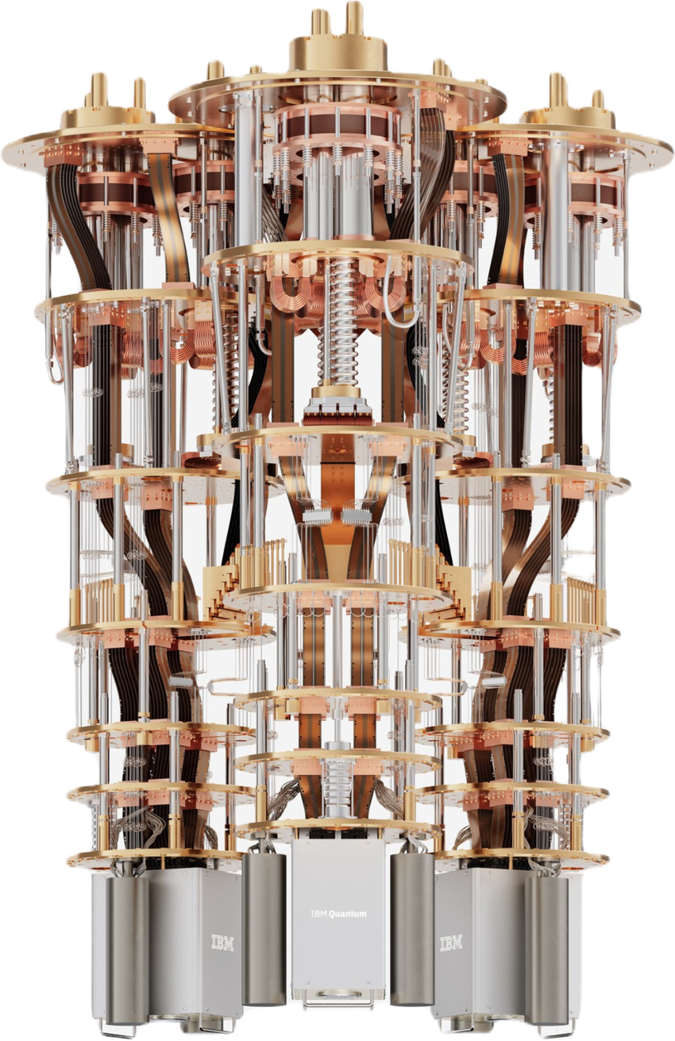
Big Five of Post-Quantum Cryptography:
Lattices
Codes
Isogenies
Hash Functions
Multivariate Polynomials

Slide 3
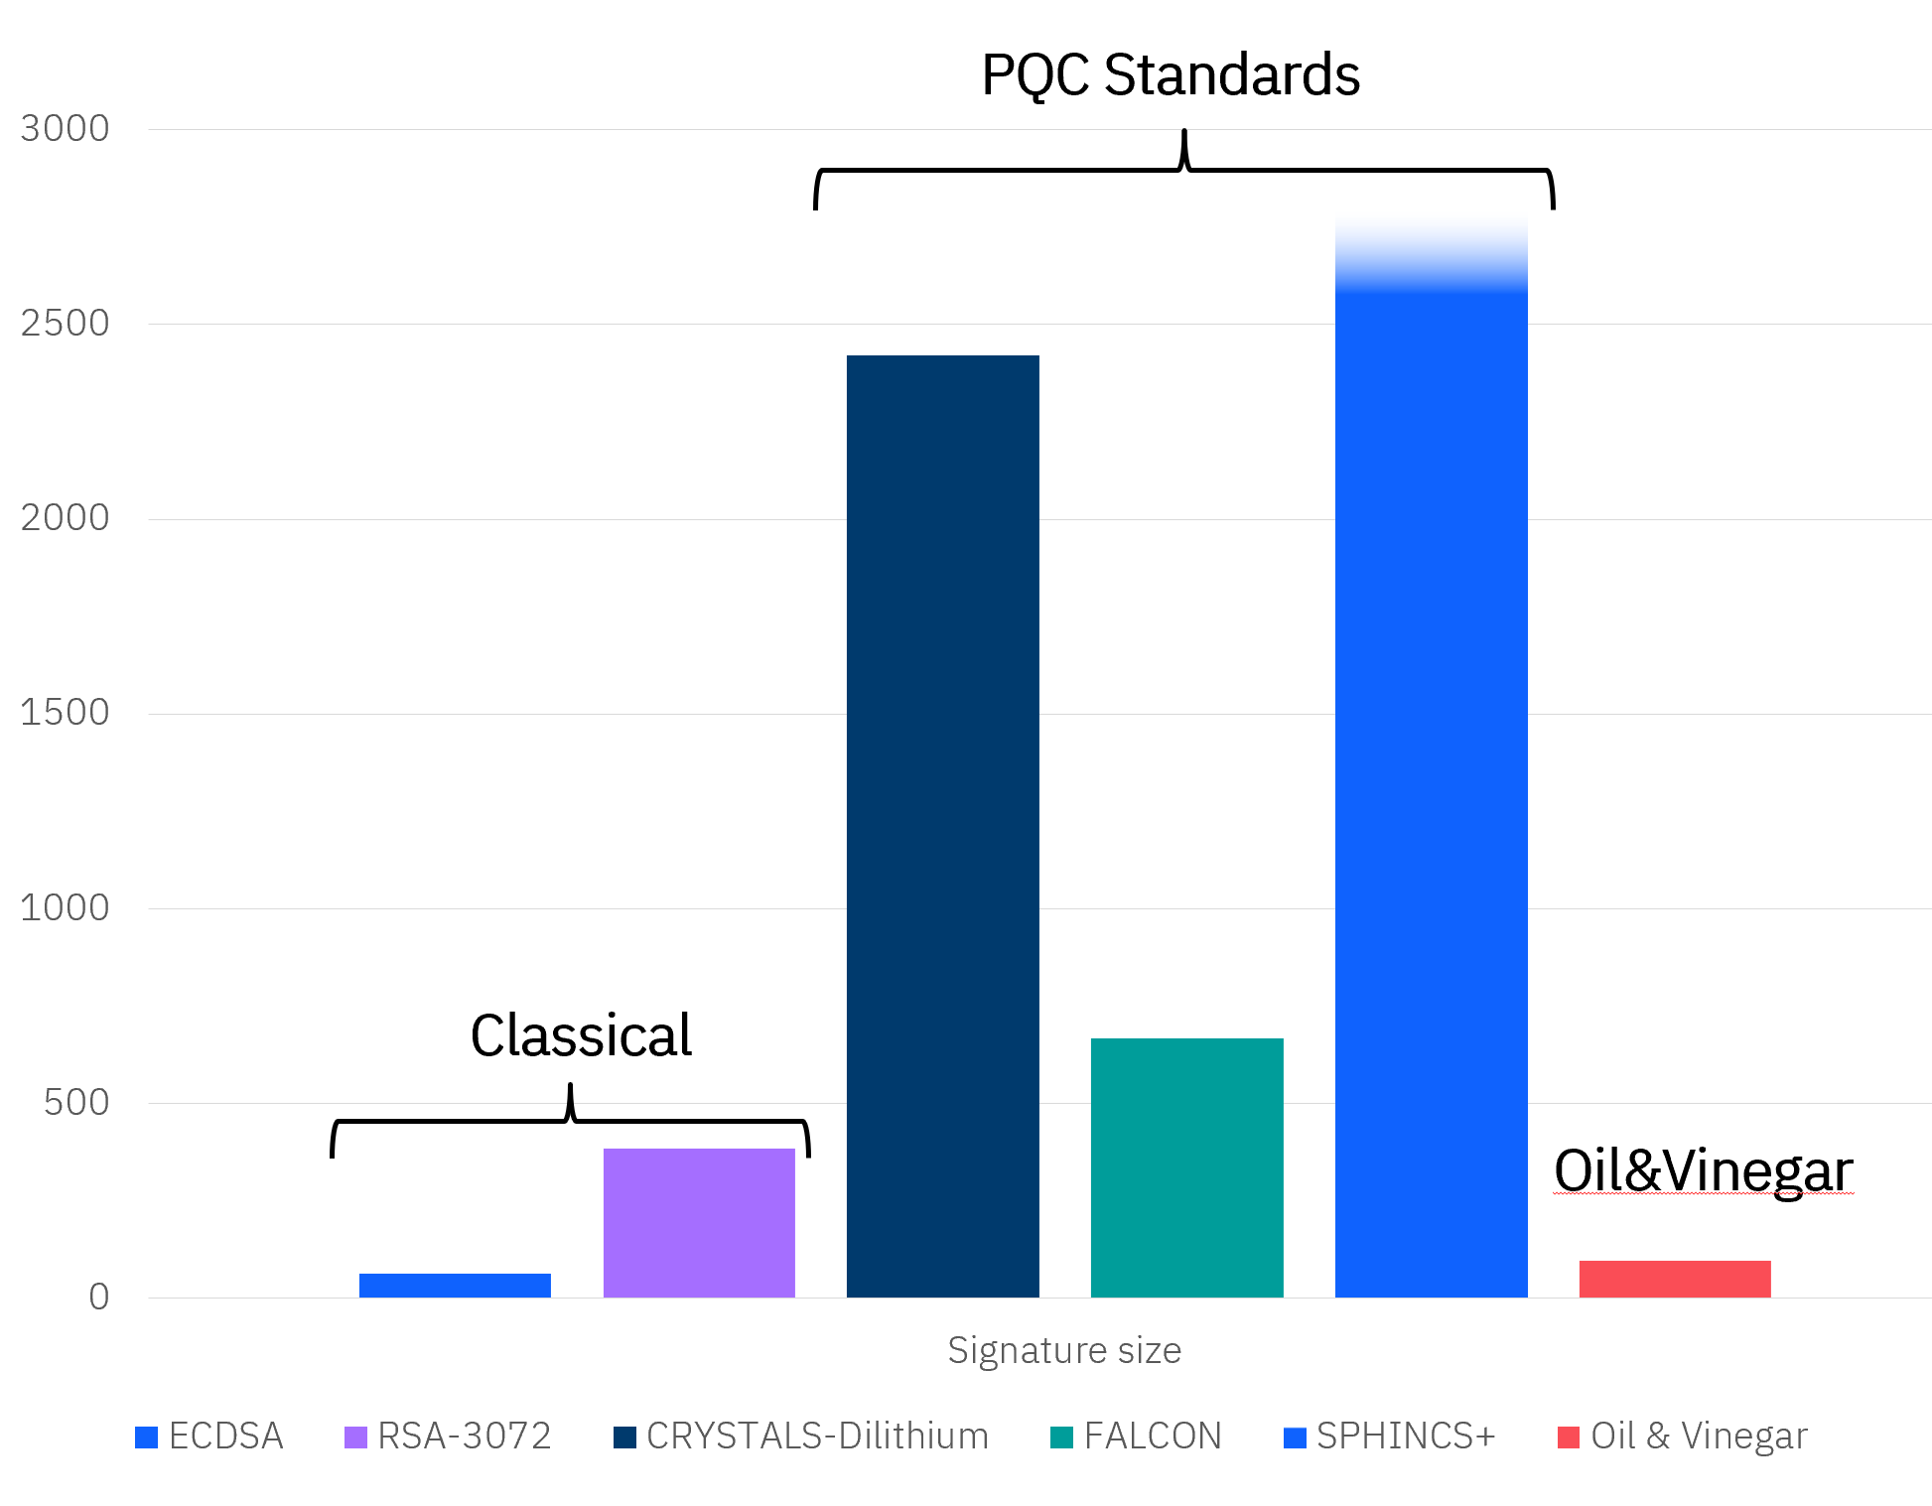
Lattice based signatures have just been standardized, why do we need multivariate signatures?
Diversification
Compact signatures
Simplicity

Slide 4
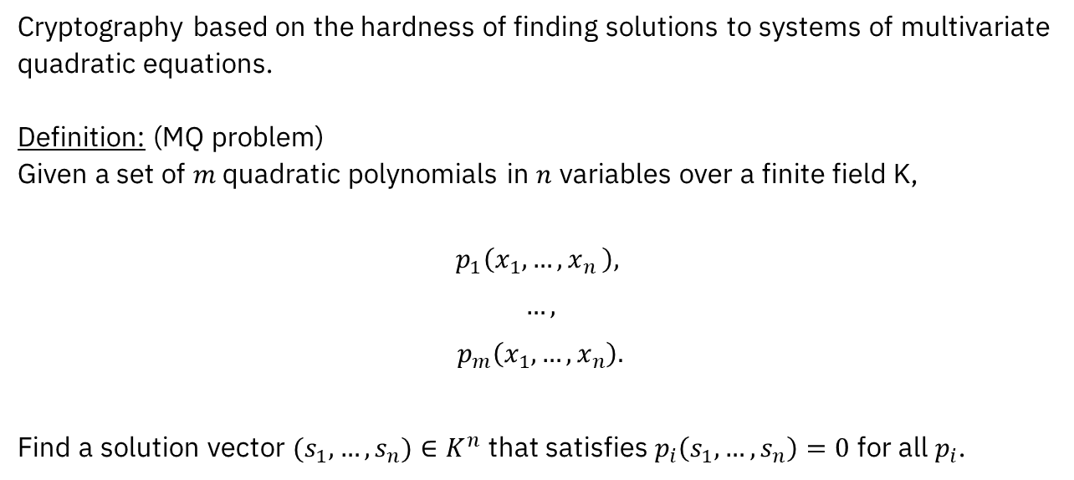
Multivariate Quadratic Cryptography
Cryptography based on the hardness of finding solutions to systems of multivariate quadratic equations. Definition: (MQ problem) Given a set of $m$ quadratic polynomials in $n$ variables over a finite field K,
$$p_{1}\left(x_{1},…{,x}_{n}\right),$$
$$…,$$
$$p_{m}\left(x_{1},…,x_{n}\right).$$
Find a solution vector $(s_{1},…,s_{n})∈K^{n}$ that satisfies $p_{i}\left(s_{1},…,s_{n}\right)=0$ for all $p_{i}$.

Slide 5
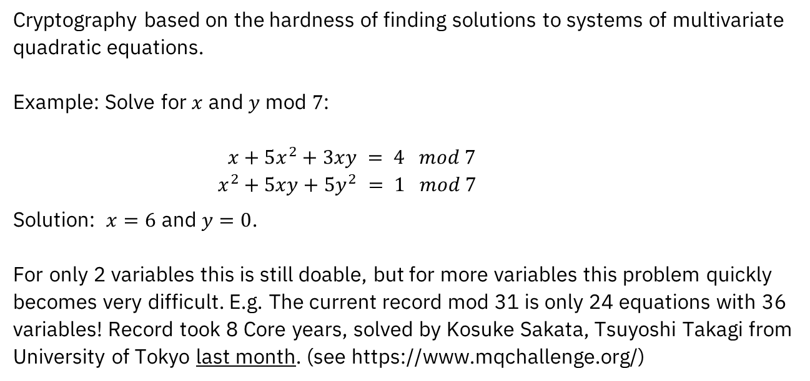
Multivariate Quadratic Cryptography
Cryptography based on the hardness of finding solutions to systems of multivariate quadratic equations. Example: Solve for $x$ and $y$ mod $7$: $x+5x^{2}+3xy = 4 mod 7$ $x^{2}+5xy+5y^{2} = 1 mod 7$
Solution: $x=6$ and $y=0$. For only 2 variables this is still doable, but for more variables this problem quickly becomes very difficult. E.g. The current record mod 31 is only 24 equations with 36 variables! Record took 8 Core years, solved by Kosuke Sakata, Tsuyoshi Takagi from University of Tokyo last month. (see https://www.mqchallenge.org/)

Slide 6
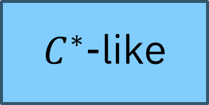
Multivariate Signatures
Pure MQ
Trapdoors
MQDSS/SOFIA
MUDFiSh
Mesquite
MQOM
KuMQuat
…
Oil and Vinegar-like
$C^{∗}$-like

Slide 7
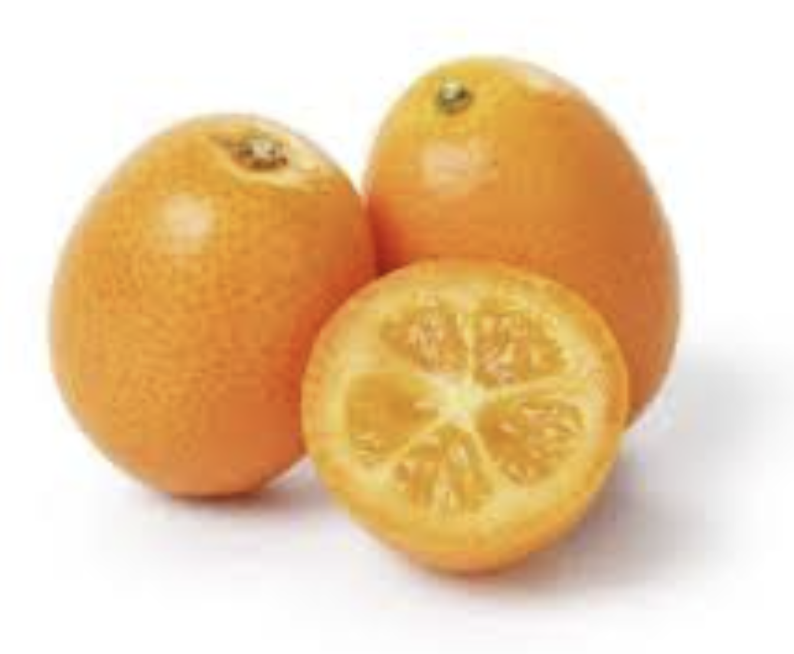
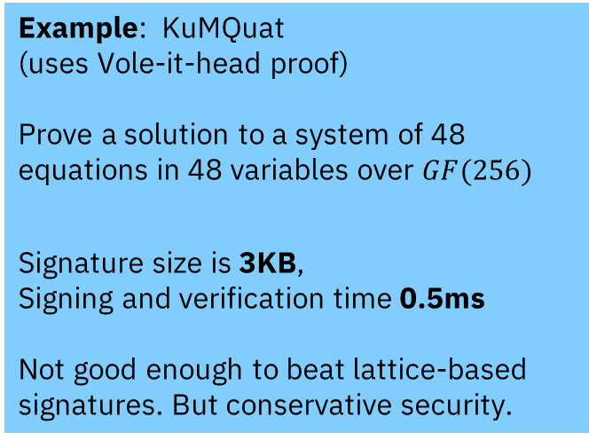
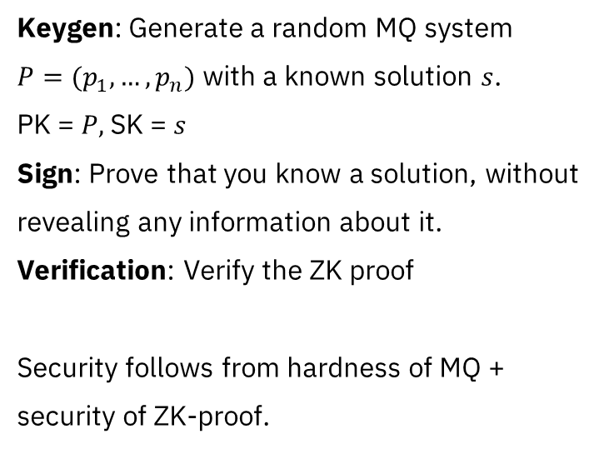
Pure MQ signatures: ZK proofs + MQ problem
Keygen: Generate a random MQ system $P=(p_{1},…,p_{n})$ with a known solution $s$. PK = $P,$SK = $s$ Sign: Prove that you know a solution, without revealing any information about it. Verification: Verify the ZK proof Security follows from hardness of MQ + security of ZK-proof.
Example: KuMQuat (uses Vole-it-head proof) Prove a solution to a system of 48 equations in 48 variables over $GF(256)$
Signature size is 3KB, Signing and verification time 0.5ms Not good enough to beat lattice-based signatures. But conservative security.

Slide 8
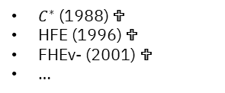
Multivariate Signatures
Pure MQ
Trapdoors
MQDSS/SOFIA
MUDFiSh
Mesquite
MQOM
KuMQuat
…
Oil and Vinegar-like
$C^{∗}$-like
$C^{∗}$ (1988) 
HFE (1996) 
FHEv- (2001) 
…

Slide 9
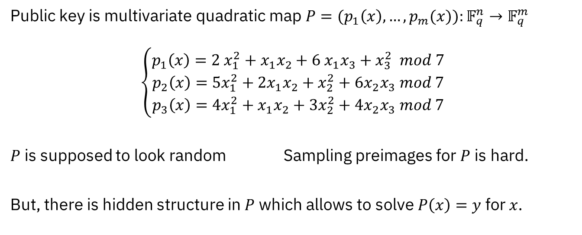
Multivariate Trapdoors
Public key is multivariate quadratic map $P=(p_{1}\left(x\right),…,p_{m}(x)):𝔽_{q}^{n}→𝔽_{q}^{m}$
$$\left\{\begin{aligned}p_{1}\left(x\right)={2 x}_{1}^{2}+{x_{1}x}_{2}+6 x_{1}x_{3}+x_{3}^{2} mod 7 \\ p_{2}\left(x\right)={5x}_{1}^{2}+{2x}_{1}x_{2}+x_{2}^{2}+{6x}_{2}x_{3} mod 7 \\ p_{3}\left(x\right)={4x}_{1}^{2}+x_{1}x_{2}+{3x}_{2}^{2}+{4x}_{2}x_{3} mod 7\end{aligned}\right.$$
$P$ is supposed to look random Sampling preimages for $P$ is hard.
But, there is hidden structure in $P$ which allows to solve $P\left(x\right)=y$ for $x$.

Slide 10
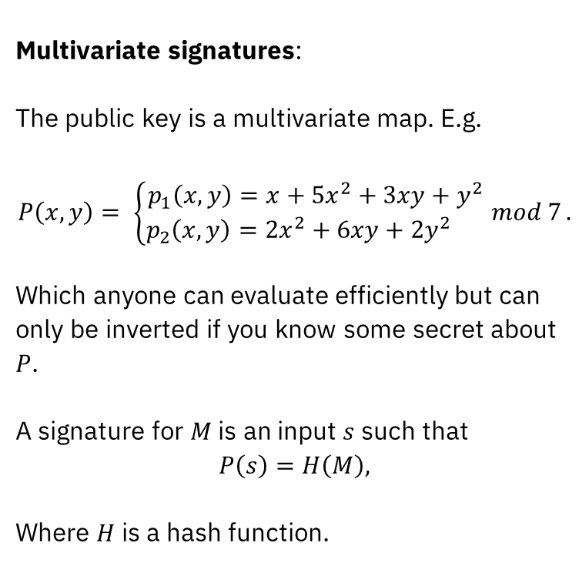
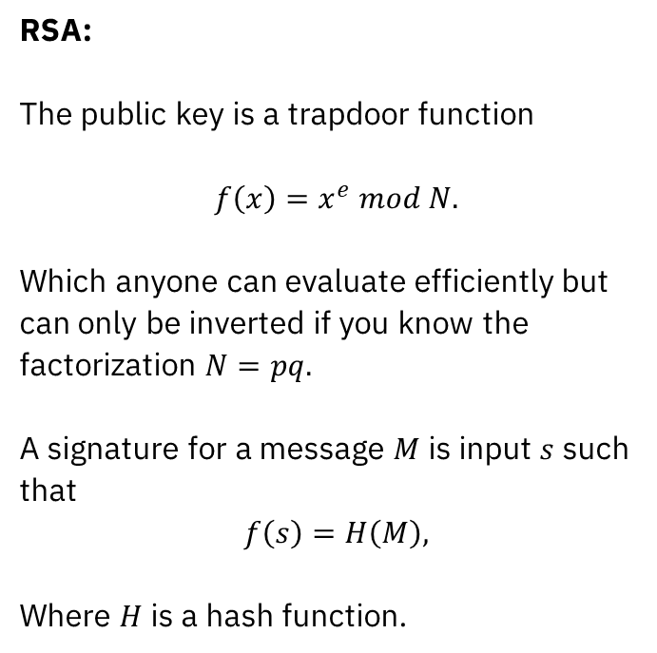
Trapdoor signatures
Multivariate signatures:
The public key is a multivariate map. E.g.
$$P\left(x,y\right)= \left\{\begin{aligned}p_{1}\left(x,y\right)=x+5x^{2}+3xy+y^{2} \\ p_{2}\left(x,y\right)=2x^{2}+6xy+2y^{2} \end{aligned} mod 7\right..$$
Which anyone can evaluate efficiently but can only be inverted if you know some secret about $P$. A signature for $M$ is an input $s$ such that
$$P\left(s\right)=H\left(M\right),$$
Where $H$ is a hash function.
RSA:
The public key is a trapdoor function
$$f\left(x\right)=x^{e} mod N.$$
Which anyone can evaluate efficiently but can only be inverted if you know the factorization $N=pq.$ A signature for a message $M$ is input $s$ such that
$$f\left(s\right)=H\left(M\right),$$
Where $H$ is a hash function.

Slide 11
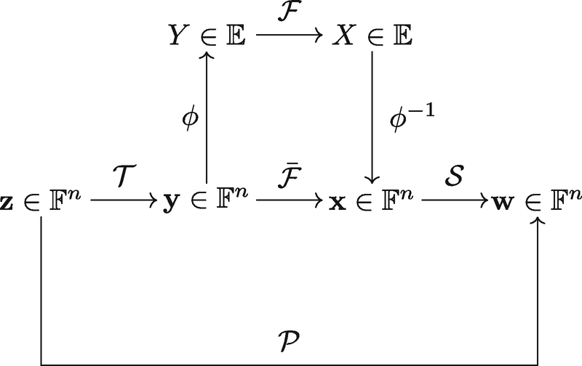
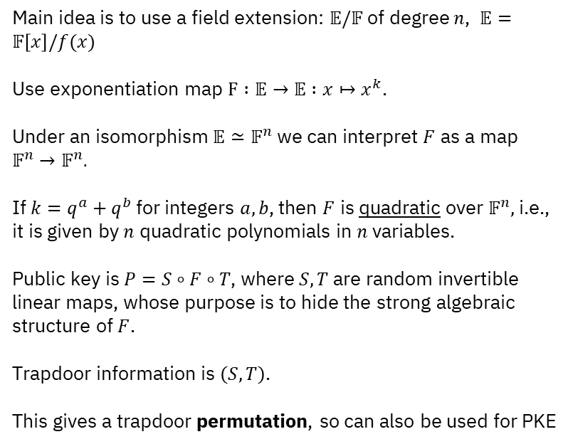
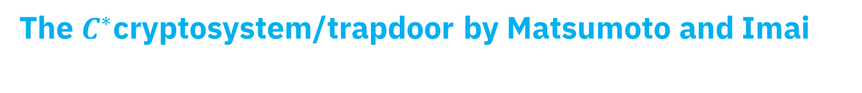
The $C^{∗}$cryptosystem/trapdoor by Matsumoto and Imai
Main idea is to use a field extension: $𝔼/𝔽$ of degree $n$, $𝔼=𝔽\left[x\right]/f(x)$ Use exponentiation map $F :𝔼→𝔼 :x↦x^{k}$. Under an isomorphism $𝔼≃𝔽^{n}$ we can interpret $F$ as a map $𝔽^{n}→𝔽^{n}.$ If ${k=q}^{a}+q^{b}$ for integers $a,b$, then $F$ is quadratic over $𝔽^{n},$ i.e., it is given by $n$ quadratic polynomials in $n$ variables. Public key is $P=S∘F∘T$, where $S,T$are random invertible linear maps, whose purpose is to hide the strong algebraic structure of $F$. Trapdoor information is $\left(S,T\right)$. This gives a trapdoor permutation, so can also be used for PKE

Slide 12

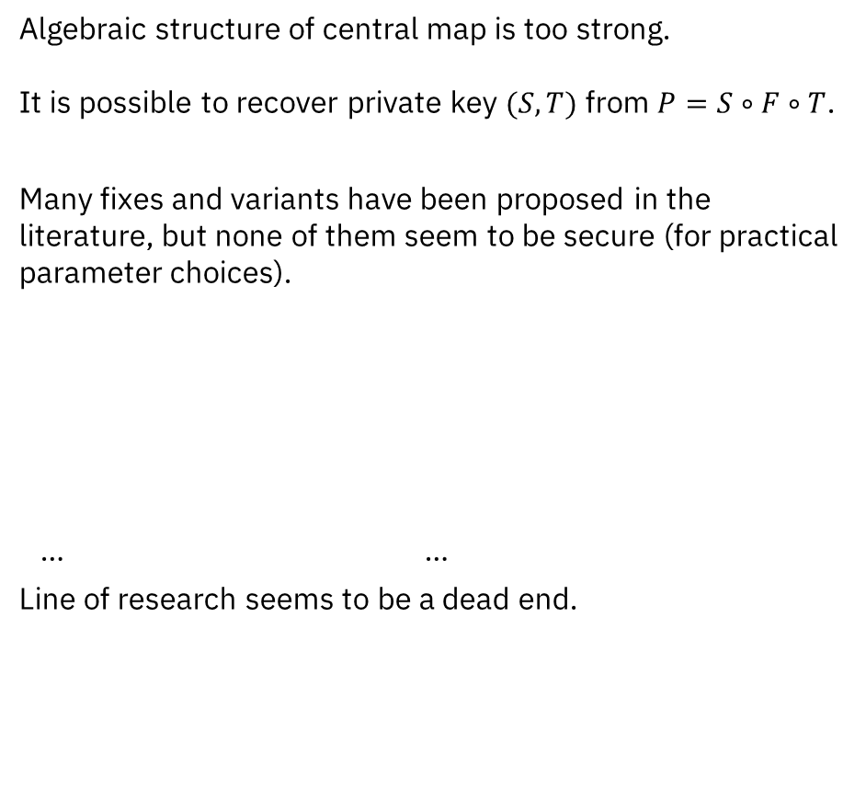
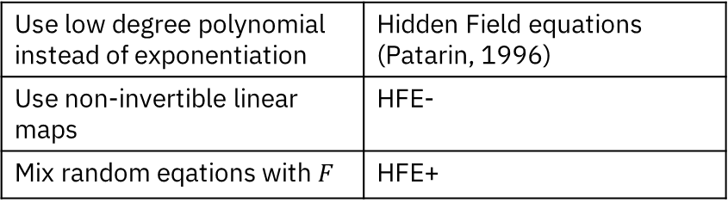
Unfortunately C*-style cryptosystems are not secure.
Algebraic structure of central map is too strong. It is possible to recover private key $(S,T)$ from $P=S∘F∘T$.
Many fixes and variants have been proposed in the literature, but none of them seem to be secure (for practical parameter choices).
… …
Line of research seems to be a dead end.
Use low degree polynomial instead of exponentiation | Hidden Field equations (Patarin, 1996)
Use non-invertible linear maps | HFE-
Mix random eqations with $F$ | HFE+

Slide 13
Multivariate Signatures
Pure MQ
Trapdoors
MQDSS/SOFIA
MUDFiSh
Mesquite
MQOM
KuMQuat
…
Oil and Vinegar-like
$C^{∗}$-like
Oil & Vinegar
Rainbow 
MAYO
QR-UOV
SNOVA
$C^{∗}$ (1988) 
HFE (1996) 
FHEv- (2001) 
…

Slide 14
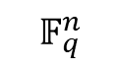
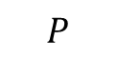
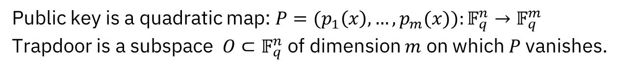
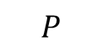
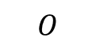
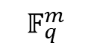
Oil & Vinegar Trapdoor
Public key is a quadratic map: $P=(p_{1}\left(x\right),…,p_{m}(x)):𝔽_{q}^{n}→𝔽_{q}^{m}$
Trapdoor is a subspace $O⊂𝔽_{q}^{n}$ of dimension $m$ on which $P$ vanishes.
$$𝔽_{q}^{n}$$
$$𝔽_{q}^{m}$$
$$P$$
$$O$$
$$P$$
.
0
Key recovery is a natural generalization of the MQ problem!

Slide 15
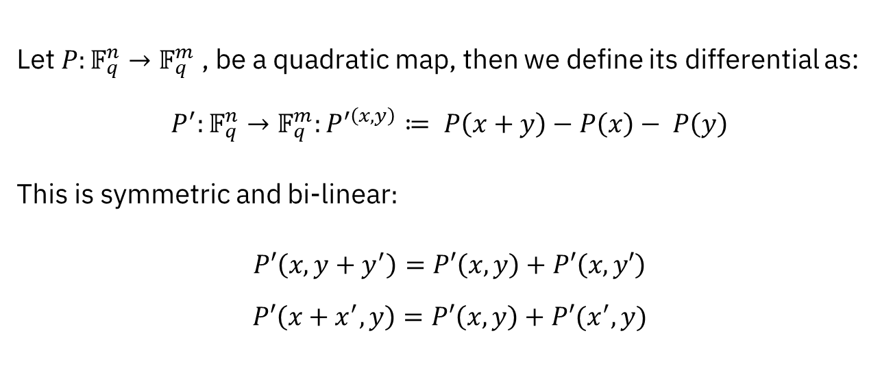
Definition of differential:
Let $P:𝔽_{q}^{n}→𝔽_{q}^{m}$, be a quadratic map, then we define its differential as:
$$P^{′}:𝔽_{q}^{n}→𝔽_{q}^{m}:P^{′\left(x,y\right)}≔ P\left(x+y\right)−P\left(x\right)− P\left(y\right)$$ This is symmetric and bi-linear$:$
$$P′\left(x,y+y^{′}\right)=P′\left(x,y\right)+P′\left(x,y′\right)$$
$$P′\left(x+x^{′},y\right)=P′\left(x,y\right)+P′(x^{′},y)$$

Slide 16
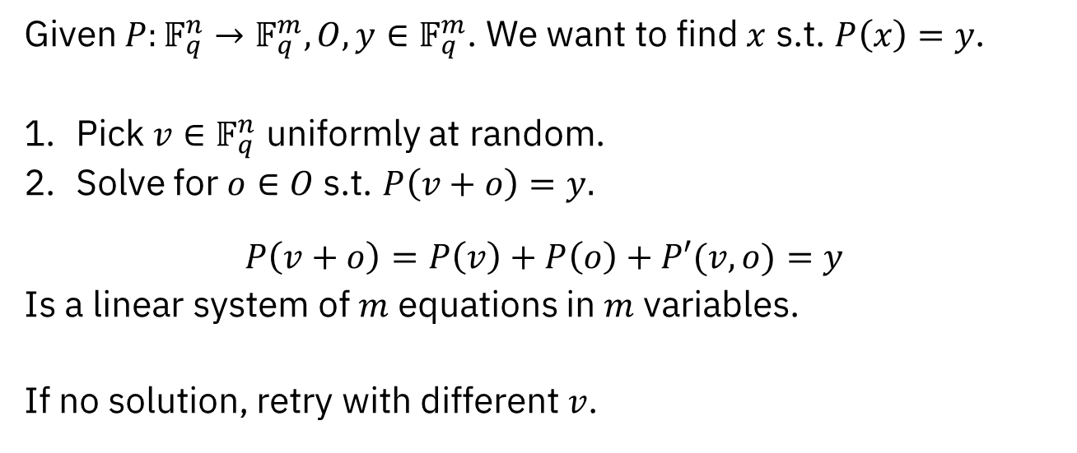

Using the trapdoor $O$
Given $P:𝔽_{q}^{n}→𝔽_{q}^{m}, O, y∈𝔽_{q}^{m}$. We want to find $x$ s.t. $P\left(x\right)=y$.
Pick $v∈𝔽_{q}^{n}$ uniformly at random.
Solve for $o∈O$ s.t. $P\left(v+o\right)=y.$
$$P\left(v+o\right)=P\left(v\right)+P\left(o\right)+P′(v,o)=y$$
Is a linear system of $m$ equations in $m$ variables.
If no solution, retry with different $v$.

Slide 17
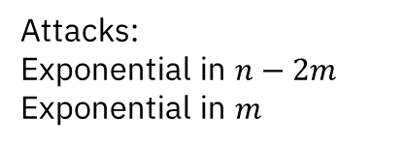
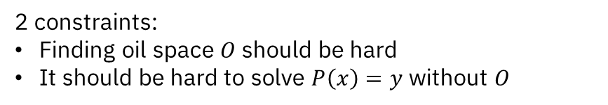
Parameters (128 bits of security)
2 constraints:
Finding oil space $O$ should be hard
It should be hard to solve $P\left(x\right)=y$ without $O$
Attacks:
Exponential in $n−2m$ Exponential in $m$
 | UOV-Ip | UOV-Is
# Variables | 112 | 160
# Equations | 44 | 64
Finite Field | GF(256) | GF(16)
Pk size | 44 KB | 67 KB
Signature size | 128 B | 96 B
Signature size is better than Lattice-based signatures, but public keys are larger.

Slide 18
Variants of Oil & Vinegar
4 multivariate digital signatures in 2nd round of NIST on-ramp:
Add whipping structure
UOV | MAYO
QR-UOV | SNOVA
Add extension field structure

Slide 19
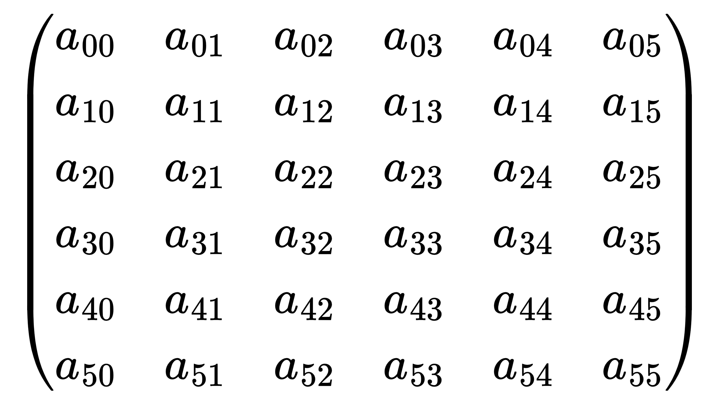
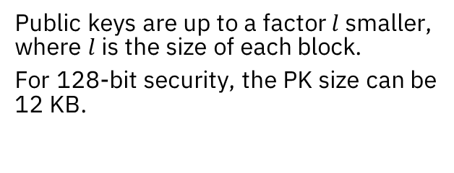
Variants of Oil & Vinegar: QR-UOV
“QR-UOV is to UOV, what Ring-LWE is to LWE.” QR-UOV is a version of UOV, where the matrix representation of the public polynomials have a block structure. Each block represents multiplication in a field extension. This extra structure makes the matrices cheaper to represent.
Public keys are up to a factor $l$ smaller, where $l$ is the size of each block.
For 128-bit security, the PK size can be 12 KB.

Slide 20

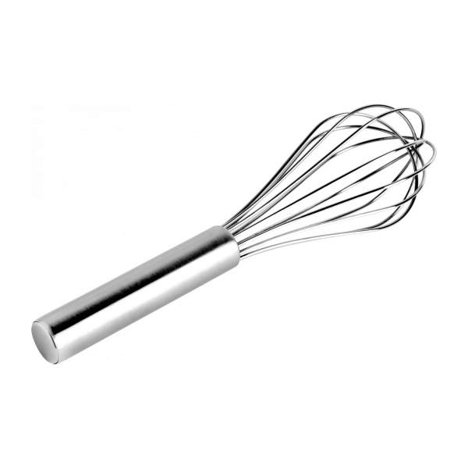
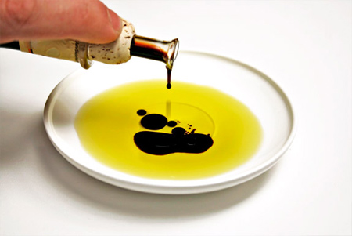
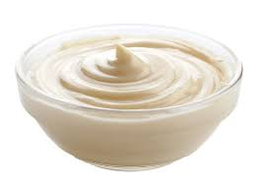
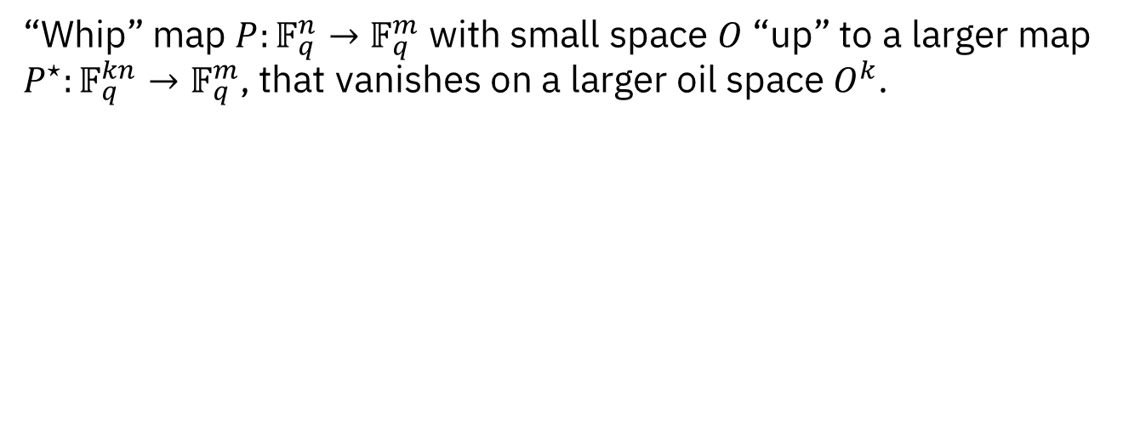
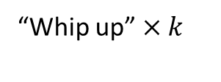


MAYO in a Nutshell
“Whip” map $P:𝔽_{q}^{n}→𝔽_{q}^{m}$ with small space $O$ “up” to a larger map $P^{⋆}:𝔽_{q}^{kn}→𝔽_{q}^{m}$, that vanishes on a larger oil space $O^{k}$.
“Whip up” $×k$
$$P:𝔽_{q}^{n}→𝔽_{q}^{m}$$
$$P^{⋆}:𝔽_{q}^{kn}→𝔽_{q}^{m}$$

Slide 21

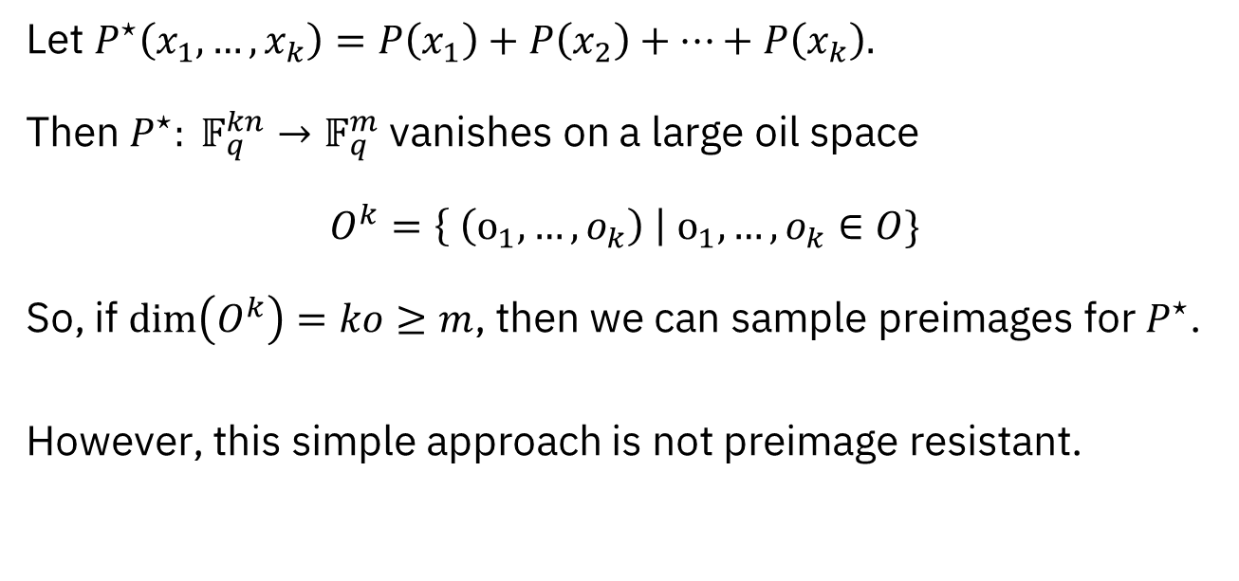
Whipping Oil-and-Vinegar: Attempt 1
Let $P^{⋆}\left(x_{1},…,x_{k}\right)=P\left(x_{1}\right)+P\left(x_{2}\right)+⋯+P\left(x_{k}\right).$ Then $P^{⋆}: 𝔽_{q}^{kn}→𝔽_{q}^{m}$ vanishes on a large oil space $$O^{k}=\left\{ \left(o_{1},…,o_{k}\right) \right| o_{1},…,o_{k}∈O\}$$ So, if $\dim\left(O^{k}\right)=ko≥m$, then we can sample preimages for $P^{⋆}$.
However, this simple approach is not preimage resistant.

Slide 22
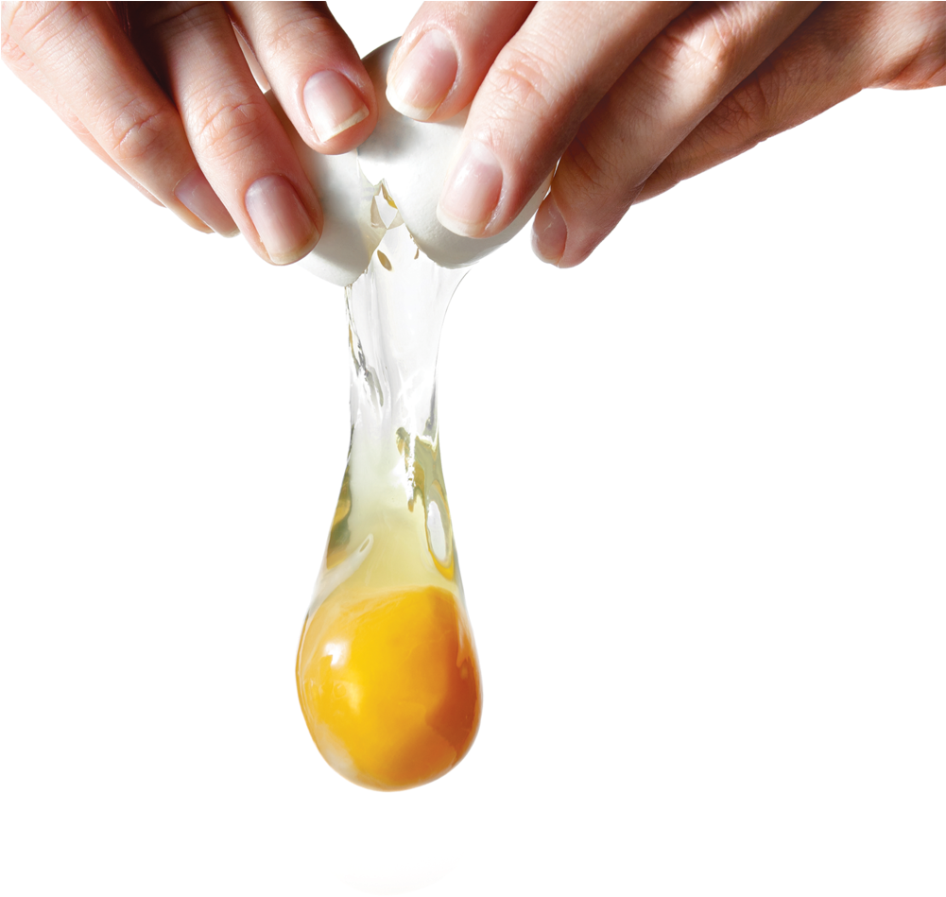
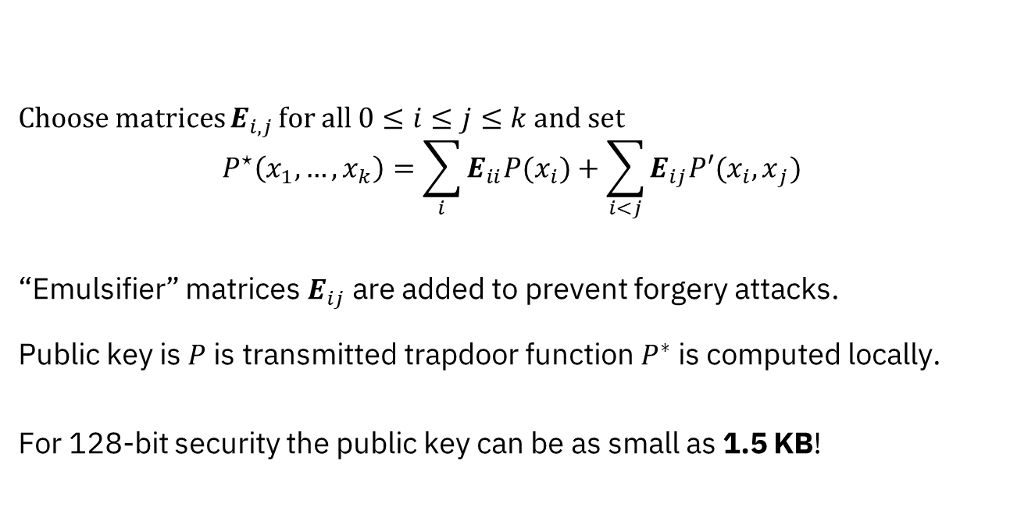
Whipping Oil-and-Vinegar
Choose matrices $E_{i,j }$for all $0≤i≤j≤k$ and set $$P^{⋆}\left(x_{1},…,x_{k}\right)=\sum_{i}{E_{ii}P(x_{i})}+\sum_{i<j}{E_{ij}P′({x_{i}, x}_{j})}$$
“Emulsifier” matrices $E_{ij}$ are added to prevent forgery attacks. Public key is $P$ is transmitted trapdoor function $P^{∗}$ is computed locally.
For 128-bit security the public key can be as small as 1.5 KB!

Slide 23
Variants of Oil & Vinegar
4 multivariate digital signatures in 2nd round of NIST on-ramp:
Add whipping structure
UOV | MAYO
QR-UOV | SNOVA
Add extension field structure

Slide 24
Variants of Oil & Vinegar
4 multivariate digital signatures in 2nd round of NIST on-ramp:
Add whipping structure
44 KB | 1.5 KB
12 KB | 1.0 KB
Add extension field structure

Slide 25
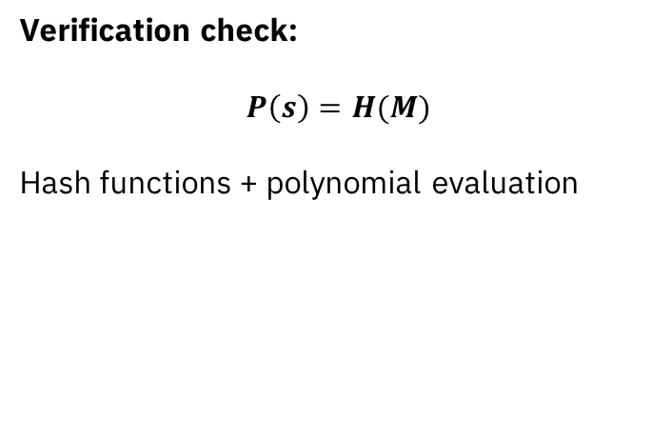
Simplicity of MQ implementations is good for going beyond signatures
Verification check: $$P\left(s\right)=H(M)$$ Hash functions + polynomial evaluation
Signing:
Hash function, matrix multiplication, and solving a system of linear equations.
Good for:
Masked implementations
Thresholdized signing
Blind signatures
…

Slide 26
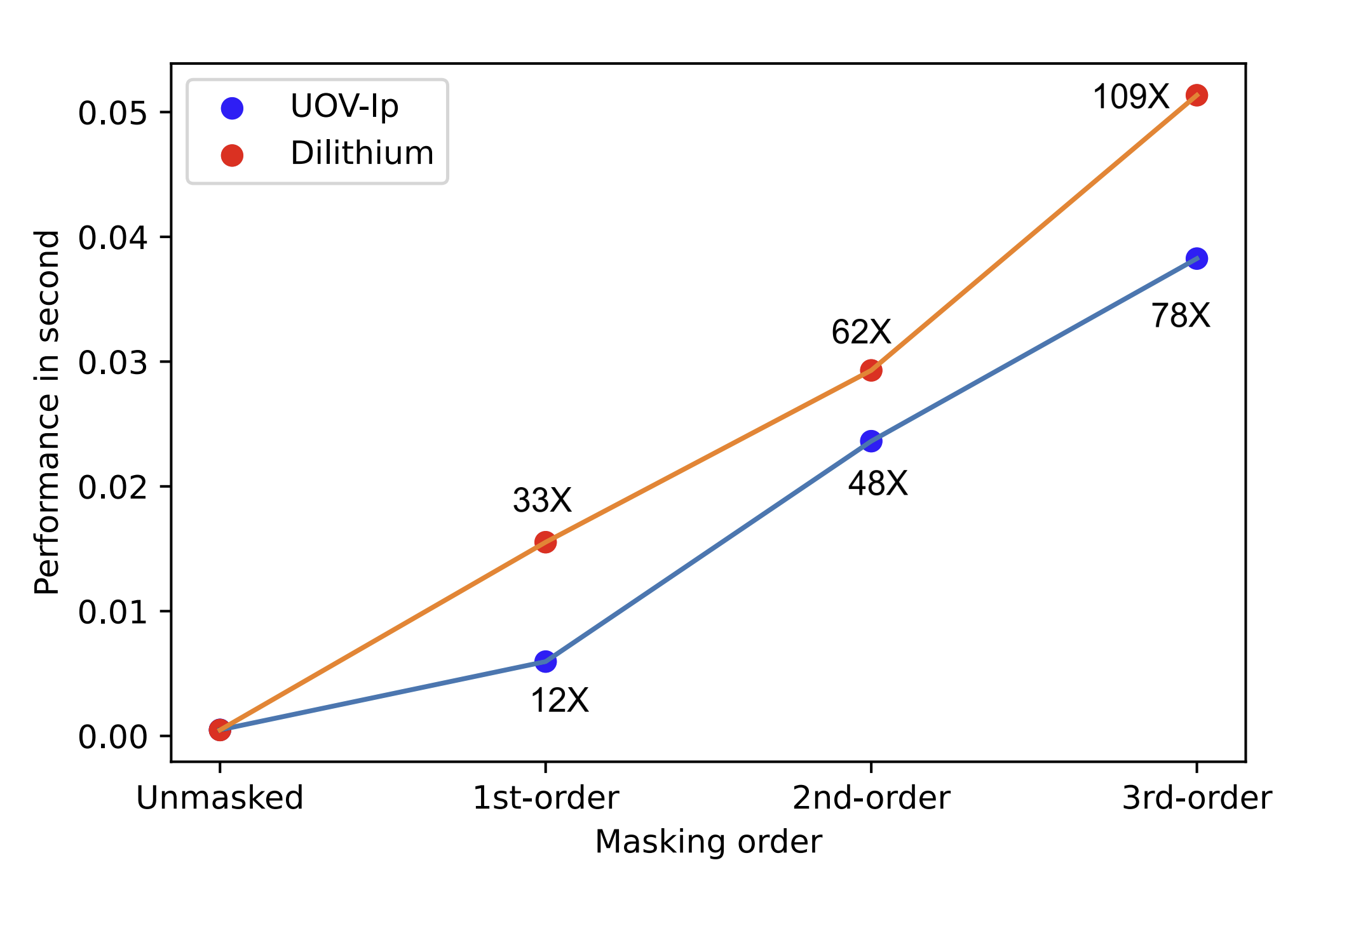
Masked implementations
Masking is a widely used tool to protect implementations against side channel attacks such as DPA. The pure arithmetic in binary fields allows for efficient masking. NO Arithmetic-to-Boolean or Boolean-to-Arithmetic conversions are needed.
Signing time of Oil&Vinegar vs Dilithium. Source: mUOV: Masking the Unbalanced Oil and Vinegar Digital Signature Scheme at First- and Higher-Order. Kundu et al. CCS ‘25

Slide 27
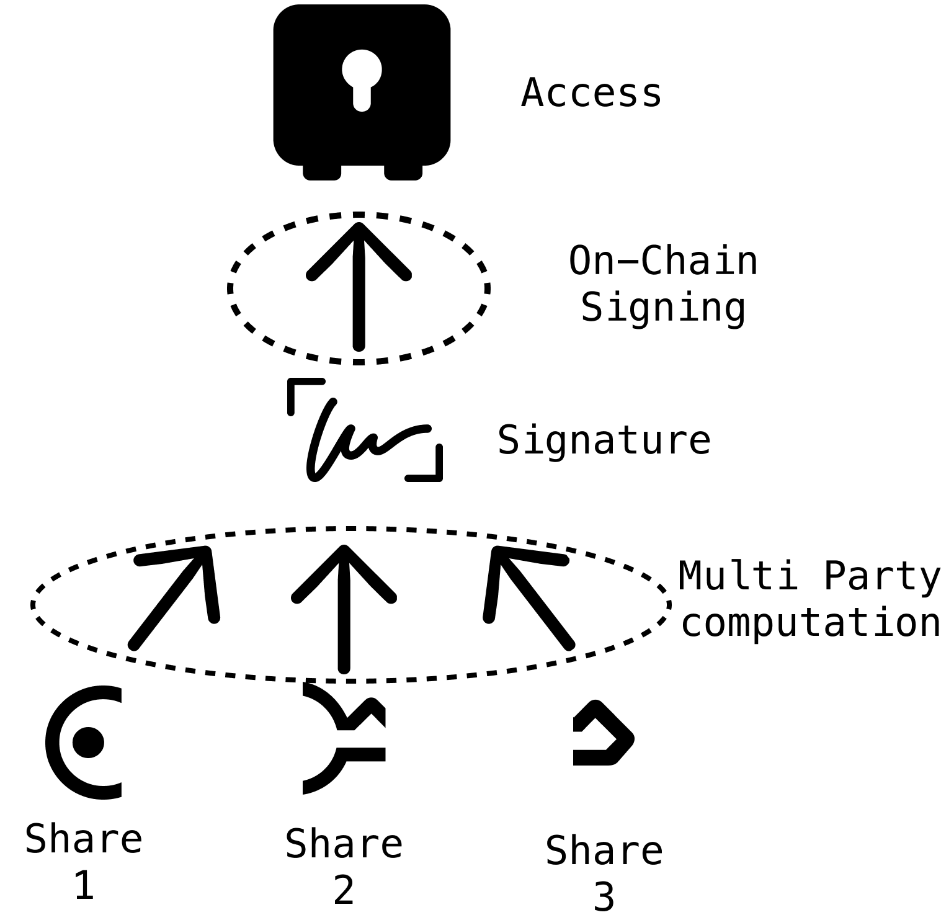
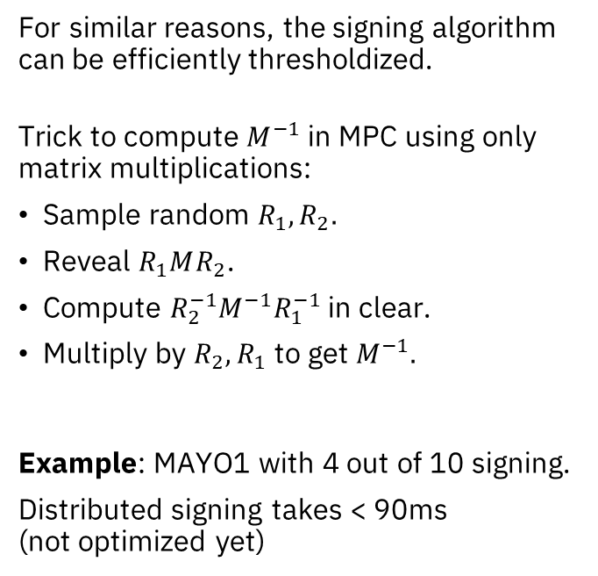
Threshold signing
For similar reasons, the signing algorithm can be efficiently thresholdized.
Trick to compute $M^{−1}$ in MPC using only matrix multiplications:
Sample random $R_{1},R_{2}.$
Reveal $R_{1}MR_{2}$.
Compute $R_{2}^{−1}M^{−1}R_{1}^{−1}$ in clear.
Multiply by $R_{2}, R_{1}$ to get $M^{−1}.$
Example: MAYO1 with 4 out of 10 signing.
Distributed signing takes < 90ms (not optimized yet)

Slide 28
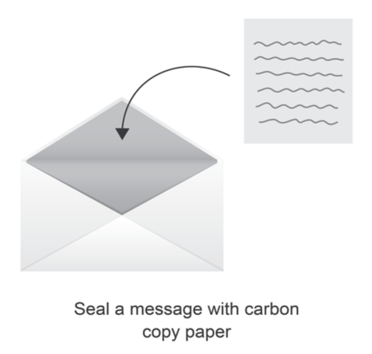
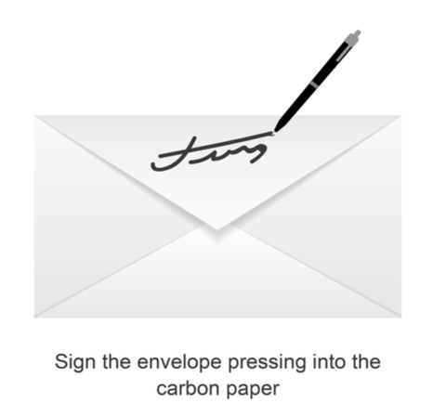
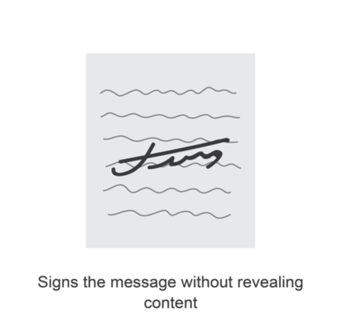
Blind signatures
Blind signatures are similar to normal digital signatures, but signing is distributed between a Client and Server. Client has a message, Server has the secret key. After some interaction the Client has a signature for his message, Server doesn’t learn anything about the message. Security = One-more unforgeabilty and Blindness (Client Privacy)

Slide 29
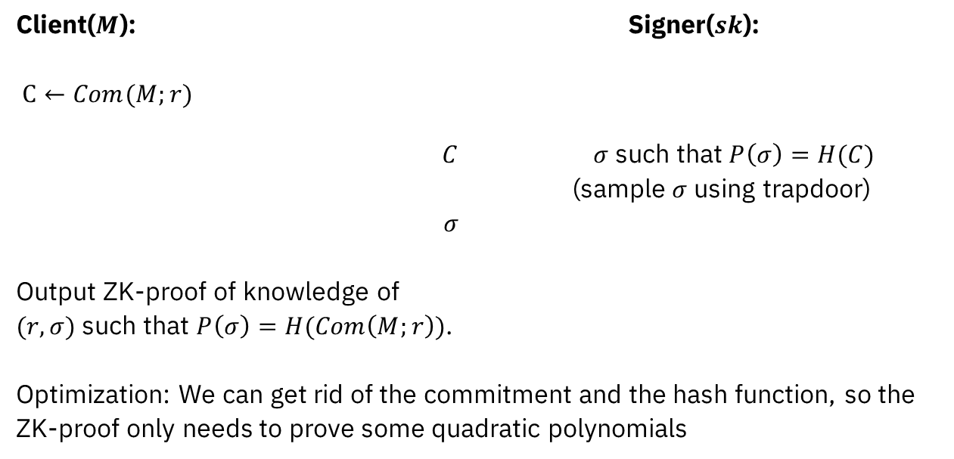
Multivariate Blind signatures
Client($M$): Signer($sk$): $C←Com(M;r)$
$C$ $σ$ such that $P\left(σ\right)=H(C)$
(sample $σ$ using trapdoor)
$σ$
Output ZK-proof of knowledge of $(r,σ)$ such that $P\left(σ\right)=H(Com\left(M;r\right))$.
Optimization: We can get rid of the commitment and the hash function, so the ZK-proof only needs to prove some quadratic polynomials

Slide 30
Implementation & Performance
This results in round optimal blind signatures which are more efficient than state-of-the art [1,2] lattice-based blind signature schemes.
[1] Lyubashevsky et al. The LaZer library: Lattice-based zero knowledge andsuccinct proofs for quantum-safe privacy.
[2] Beullens et al. Lattice-based blind signa-tures: Short, efficient, and round-optimal.

Slide 31
Open problems:
Conclusion:
Multivariate signatures have small signatures, good performance and are mathematically simple. This simplicity lends itself to more efficient secure implementations and advanced primitives, especially when using multivariate schemes over fields of characteristic 2.
Construct a PKE from multivariate crypto.
Unified security analysis of schemes based on reductions to well-studied assumptions. (á la SIS & LWE)
Concrete security of UOV-variants MAYO, QR-UOV, SNOVA.

